Slide 1
Neural Language Model
Radhika B
Guest Faculty (GF-1973)
Birla Institute of Technology & Science, Pilani

Slide 2
Agenda
Neural Language Models
Feedforward Neural Network Basics
Transformers for beginners - What are they and how do they work?
Inside the Transformer Architecture
Summary
Demo Session

Slide 3
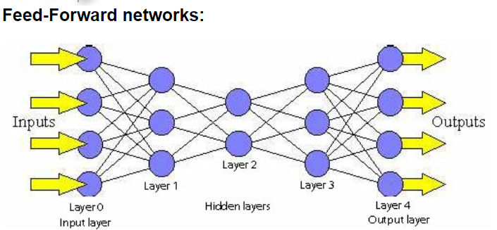
Feedforward Neural Network Basics

Slide 4
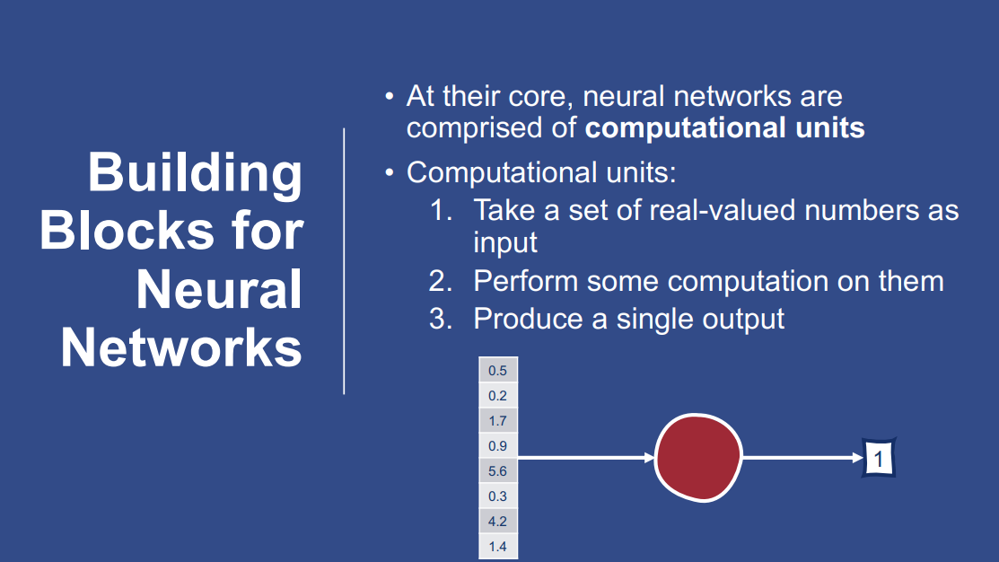
Neural Language Models

Slide 5
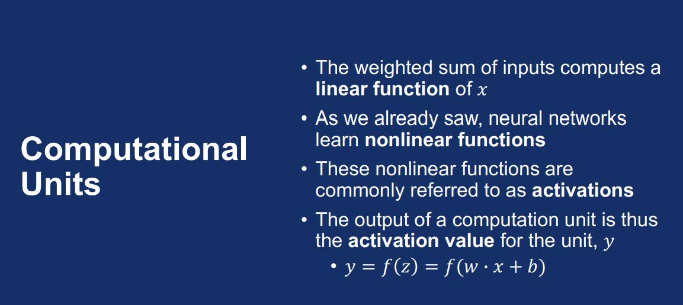
Neural Language Models

Slide 6
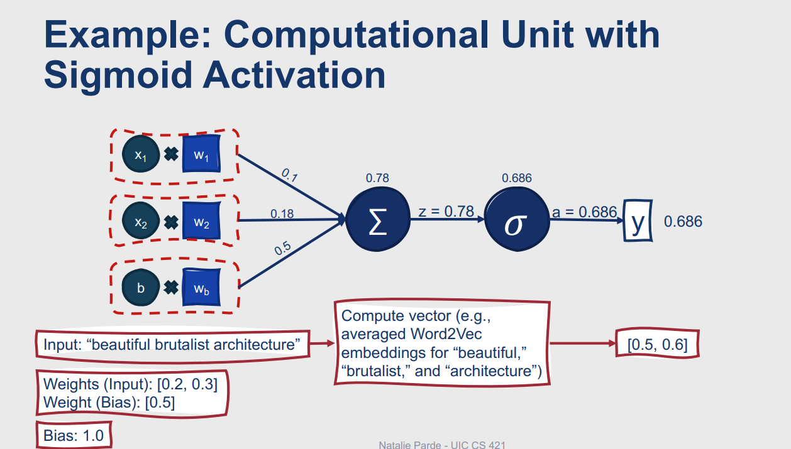
Neural Language Models

Slide 7
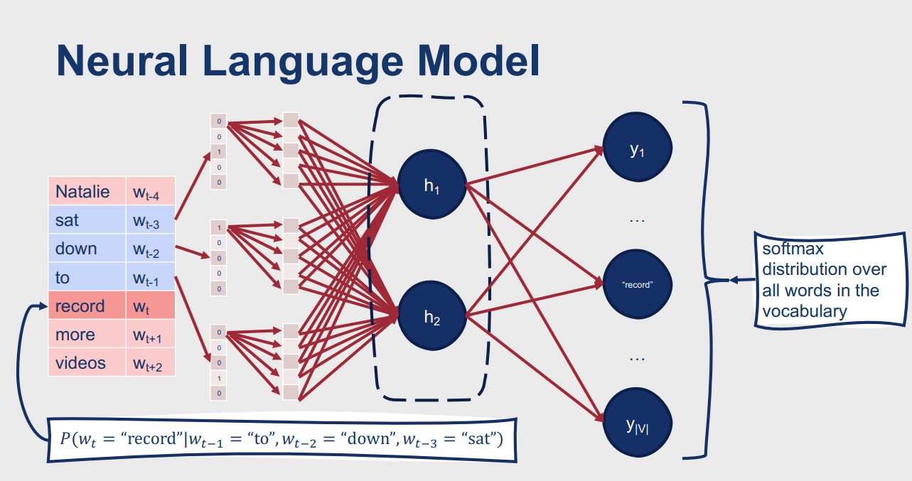
Neural Language Models

Slide 8
Transformers for beginners - What are they and how do they work ?
The Rise of Transformers in NLP
Inside the Transformer Architecture
Key Ideas in Transformer Architecture
Multi-Headed Attention
Understanding Multi-Headed Attention in Transformers
Positional Encoding: A Solution to Word Order Ambiguity
Bringing It All Together: How Transformers Operate
Final Thoughts on Transformers: Simplicity in Complexity

Slide 9
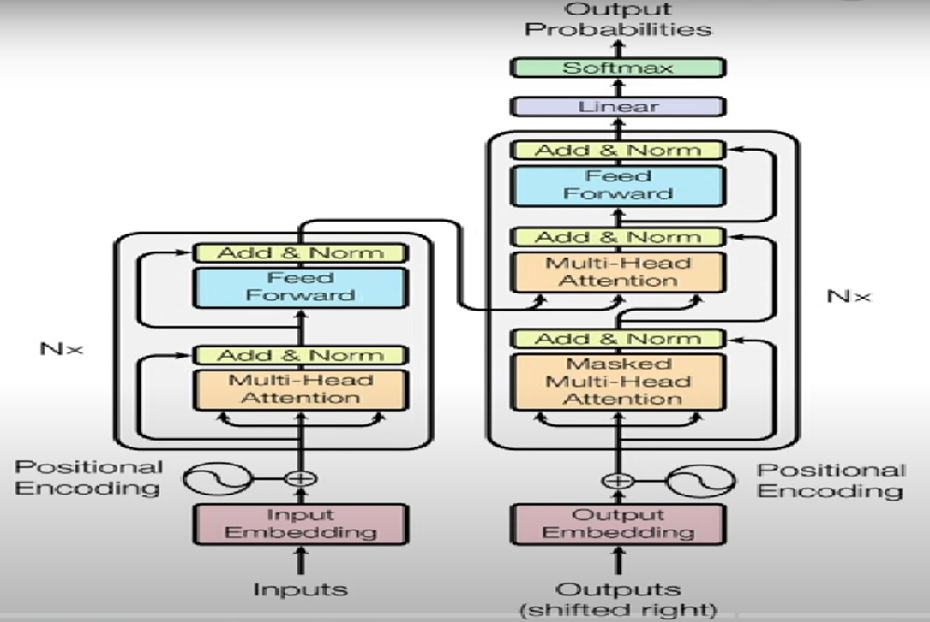
Inside the Transformer Architecture

Slide 10
Inside the Transformer Architecture…
Input Embedding
Positional Encoding
Multi-Head Attention: Query, Key-Value, Attention, Weighted Sum
Add & Norm
Feed Forward
Output Embedding
SoftMax

Slide 11
How a Transformer works in machine translation ?
The Transformer will act primarily as a decoder-only model, or a model where the "encoder" is implicitly handling the initial prompt. Many popular large language models (LLMs) like GPT-3, GPT-4, Llama, etc., are primarily decoder-only Transformers.
I. Input Processing (The Prompt: "The old clock tower stood silent...")
Input Embedding:
Concept: Each word in the input prompt is converted into a numerical vector (embedding).
Example:
"The" → embedding vector for "The"
"old" → embedding vector for "old"
...
"silent" → embedding vector for "silent"
Why: To convert human-readable text into a format the model can process.

Slide 12
How a Transformer works in machine translation ?...
Positional Encoding:
Concept: Information about the order of words in the prompt is added to the embeddings.
Example: The embedding for "The" gets a positional signal for position 1, "old" for position 2, and so on.
Why: To preserve the sequence and meaning of the prompt. "Clock tower old" means something different from "old clock tower."

Slide 13
How a Transformer works in machine translation ?...
II. The Decoder (Generating the Story)
The decoder's primary function here is to predict the next word in the sequence, based on all the words that have come before it (both the prompt and the words it has already generated). This process is repeated until a "stop" token is generated or a desired length is reached.
Masked Multi-Head Self-Attention:
Concept: This is the most critical part for text generation. When the model is trying to predict the next word, it looks at all the previous words (the prompt + already generated words) to understand the context. The "masked" part ensures it doesn't "cheat" by looking at future words.
Example:
Initial Step (Predicting the first word after "silent"): The model attends to "The," "old," "clock," "tower," "stood," "silent." It processes these words and their relationships.
Let's say it generates "One": Now, for the next prediction, the input to the decoder includes "The old clock tower stood silent One".
Predicting the word after "One": The model attends to all words from "The" up to "One." It might focus on "clock tower" and "silent" to suggest something related to time or stillness.
Hypothetical Generation: "The old clock tower stood silent. One night, a strange light flickered from its highest window."
To generate "night," it attends to "The old clock tower stood silent. One"
To generate "a," it attends to "...silent. One night,"
And so on.
Why: This allows the model to understand the long-range dependencies and context within the growing story, ensuring coherence and relevance. For instance, if the story is about a clock tower, it will likely generate words related to time, gears, dust, etc.

Slide 14
How a Transformer works in machine translation ?...
Feed-Forward Networks and Layer Normalization:
After the attention mechanism, the contextualized representation of each word passes through a standard feed-forward neural network.
Layer normalization and residual connections are used to stabilize training and improve information flow through the layers.
The decoder typically has multiple stacked layers, with the output of one feeding into the next.

Slide 15
How a Transformer works in machine translation ?...
Output Layer (Softmax):
Concept: The final output of the decoder's last layer is passed through a linear layer and then a Softmax function. This function outputs a probability distribution over the entire vocabulary (all possible words the model knows).
Example: When the model needs to generate the word after "silent.", the Softmax layer might output probabilities like:
"Then": 0.15
"Suddenly": 0.12
"One": 0.20 (Highest probability chosen)
"But": 0.08
... (probabilities for all other words)
The word with the highest probability is typically selected as the next word. Sometimes, a sampling strategy (like nucleus sampling or top-k sampling) is used to introduce more creativity and less predictability.

Slide 16
How a Transformer works in machine translation ?...
III. The Generation Process:
The process is autoregressive, meaning each generated word becomes part of the input for generating the next word.
Initialize: Start with the prompt: "The old clock tower stood silent."
Loop:
Feed the current sequence (prompt + generated words) through the decoder.
The Softmax layer outputs a probability distribution for the next word.
Select the next word based on these probabilities.
Append the selected word to the sequence.
Repeat until a stopping condition is met (e.g., maximum length reached, or an "end of sequence" token is generated).

Slide 17
How a Transformer works in machine translation ?...
Example Story Generation Flow:
Prompt: "The old clock tower stood silent."
Generate 1st word: Model predicts "One" (Highest probability after "silent.")
Current sequence: "The old clock tower stood silent. One"
Generate 2nd word: Model predicts "night" (after "One")
Current sequence: "The old clock tower stood silent. One night"
Generate 3rd word: Model predicts ","
Current sequence: "The old clock tower stood silent. One night,"
Generate 4th word: Model predicts "a"
Current sequence: "The old clock tower stood silent. One night, a"
...and so on, until a full story is formed:
Generated Output: "The old clock tower stood silent. One night, a strange light flickered from its highest window. Whispers claimed it was the spirit of the long-lost clockmaker, finally returning to mend the broken gears of time."

Slide 18
DEMO Session

Slide 19
Thank you

